Slide 1
Small for Gestational Age
Faculty of Medicine Ragama

Slide 2
Definitions
Classification by weight
Low birth weight (LBW)
< 2500 gms
Very low birth weight (VLBW)
< 1500 gms
Extremely low birth weight (ELBW)
< 1000 gms

Slide 3
Low birth weight and SGA
Size at birth reflects two factors:
duration of gestation and
rate of fetal growth
Weight in relation to gestation and gender is an important indicator of any problems

Slide 4
Definitions
Intrauterine growth restriction (IUGR) and small for gestational age (SGA) / small for dates are used synonymously most of the time
birthweight below the 10th percentile of the recommended gender-specific birthweight for gestational age reference curves (Williams1982, WHO 1995).
Or below -2SD

Slide 5
Definitions
Intrauterine growth restriction (IUGR) has been defined as,
the rate of fetal growth that is below normal in light of the growth potential of a specific infant as per the race and gender of the fetus
neonates born with clinical features of malnutrition and in-utero growth retardation, irrespective of their birth weight percentile.

Slide 7
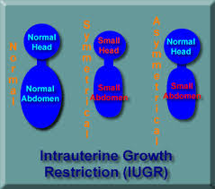
Definitions
Intrauterine growth restriction / SGA
Symmetrical (20%)
Asymmetrical (HC > Weight)
Mixed
Symmetrical (from early pregnancy)
Congenital infections
Chromosomal problems
Asymmetrical
Uteroplacental insufficiency
Maternal malnutrition
Maternal hypertension

Slide 8
Incidence of low birth weight
Sri Lanka Demographic and Health
Survey (SLDHS) 2016
16% of live births, birth weight < 2,500 g
Districts - Ratnapura, Nuwara Eliya, Matara (improved from 31% to 25% in 10 years)
Risk factors:
Younger mothers, first birth order mothers,
Mothers who did not complete primary school
Mothers in the lowest wealth quintile
Notes:
Higher prevalence of low birth weight is observed among children of younger mothers (22 percent), first birth order mothers (18 percent), children of mothers residing in the estate sector (25 percent), and children of women with no education (32 percent). The prevalence of low birth weight is negatively associated with the level of education of the mother (see Figure 10.1 below) and the household wealth. Twenty-one percent of the children born to mothers in the poorest households were registered as of low birth weight, compared to 9 percent among the richest quintil

Slide 9
Aetiology
IUGR
Genetic factors Placental factors Fetal factors Maternal factors
Copyright Deepak Sharma

Slide 10
Aetiology of IUGR
Fetal
Constitutional
Genetic syndromes, chromosomal
Structural malformations
Congenital infections (CMV, Rubella)
Maternal
Undernutrition
Maternal hypoxia
Drugs / substance abuse
Smoking (main reason in western countries)

Slide 11
Aetiology
Genetic
Chromosomal
Expression of placental growth factors (e.g.IGF-1)
Placental
Reduced maternal vascular supply
(pre-eclampsia, hypertension, DM, renal disease)
Thrombosis, infarction
(Maternal LE, antiphospholipid syndrome, sickle cell disease)
Sharing of uterine vascularity
(multiple gestation)

Slide 12
Aetiology
In developing countries, especially, maternal nutrition is an important determinant of birthweight
Inadequate maternal nutritional status before conception,
short stature of the mother (mostly due to undernutrition and repeated infections during childhood), and
poor maternal nutrition during pregnancy

Slide 13
Pathophysiology
Symmetric
Growth failure affecting weight, length and head
Caused by fetal factors
Chromosomal, infection, syndromes
If swallowing affected
Mother will have polyhydramnios
eg Trisomy 21
Infants likely to be small throughout childhood

Slide 14
Pathophysiology
Asymmetric
Growth failure with head growth relatively preserved
Utero-placental insufficiency
Reduced O₂ transfer to fetus
Fetus preserves blood supply to vital organs (brain, myocardium, adrenal glands) at expense of kidney, GI tract, limbs and subcutaneous tissues
normal head growth BUT reduced abdominal growth from reduced glycogen stores in the liver
oligohydramnios from reduced urine production
If allowed to progress - fetal acidosis and death

Slide 15
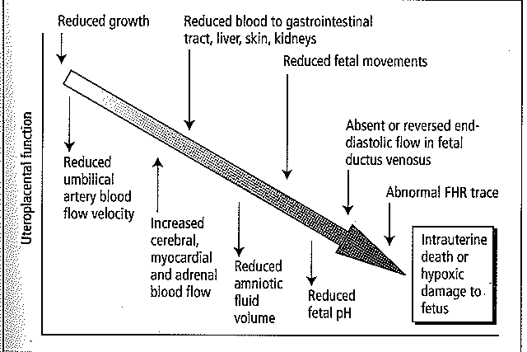
Consequences of progressive utero-placental failure

Slide 16
Antenatal care
Intensive fetal surveillance to maximize gestation without compromising the fetus
Antenatal
Reliable dating of pregnancy / identify high risk mothers
Fetal abdominal circumference as screening (SFH unreliable)
? Fetal cause (anomaly scan, karyotype)
Monitor fetal growth and well –being
(umbilical artery / middle cerebral artery doppler blood flow velocity; biophysical profile unreliable)
Delivery when indicated

Slide 17
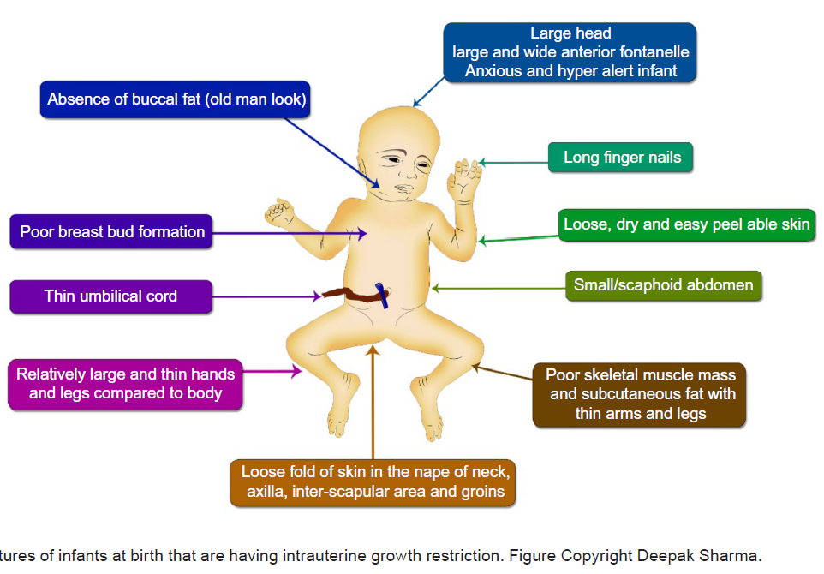
Clinical features

Slide 18
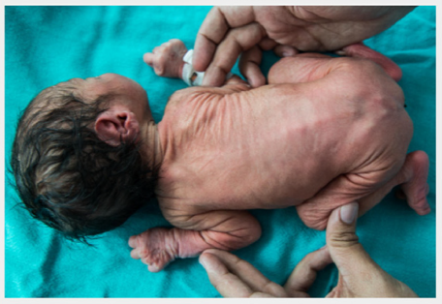
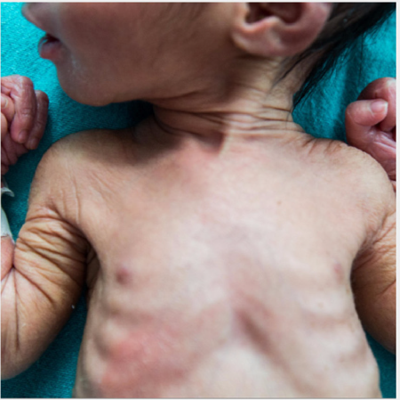
Clinical features
Large head when compared to rest of the body (brain sparing effect)
Large and wide anterior fontanelle (poor formation of membranous bones)
Absent buccal fat (old man look)
Small or scaphoid abdomen
Thin umbilical cord often stained with meconium
Decreased skeletal muscle mass and subcutaneous fat

Slide 19
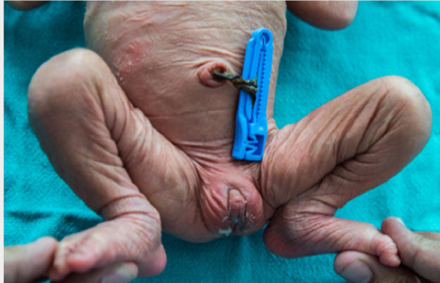
Clinical features
Loose, dry, and easy peelable skin
Long finger nails
Relatively large hands and feet compared to body
Skin having a loose fold of skin in the nape of neck, axilla, inter-scapular area, and gluteal region (more than three folds)
Anxious and hyper alert infant
Poor breast bud formation and immature female genitalia

Slide 20
Postnatal issues – short term
Perinatal asphyxia, meconium aspiration persistent pulmonary hypertension
Hypothermia
Hypoglycemia, hyperglycemia, hypocalcemia
Polycythemia, jaundice
Feeding difficulties, feed intolerance
Necrotizing enterocolitis, late-onset sepsis, pulmonary hemorrhage
Symmetrical may need further investigation for eg congenital infection

Slide 21
Postnatal issues
Poor growth
Poor neurodevelopment outcome at school-going age and adulthood
More susceptible to develop adult-onset diseases e.g. diabetes mellitus (DoHaD – Developmental origin of health and diseases)

Slide 22
Post natal care
Thermoregulation :
Normothermic range: 36.5°C to 37.5°C
Minimizes energy expenditure and oxygen consumption
Promotes adequate weight gain
Need to prevent heat loss by radiation, conduction, convection and evaporation

Slide 23
Thermoregulation
WHO definition of hypothermia:
mild 36.0°C– 36.4°C
moderate 32.0°C– 35.9°C
severe < 32.0°C

Slide 24
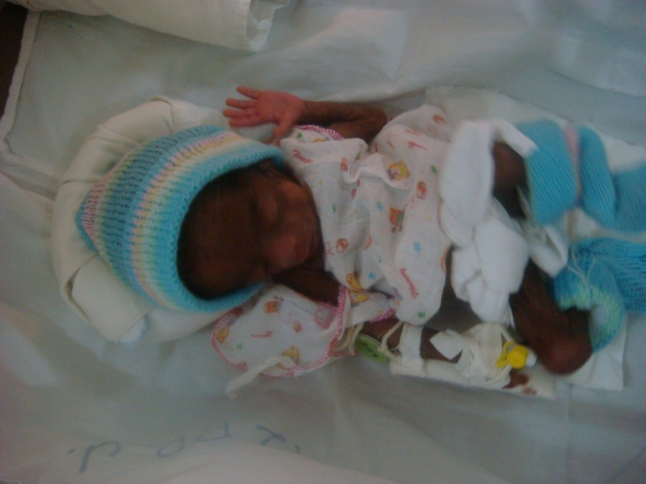
Hypothermia
How to prevent
Warm delivery room
Radiant warmer
‘warm chain’
Avoid early weighing, bathing
Use hats / socks when appropriate
Incubator if indicated
Kangaroo mother care

Slide 25
Kangaroo mother care (KMC)
What is KMC?
Newborns / infants being carried skin-to-skin
For babies <1800g
What are its advantages?
Promotes exclusive breastfeeding
Enhances parent-infant bonding
Earlier discharge from hospital
More stable vital signs; including better thermal control
Any disadvantages?
No increase in mortality / morbidity has been shown when practised with stabilised infants

Slide 26
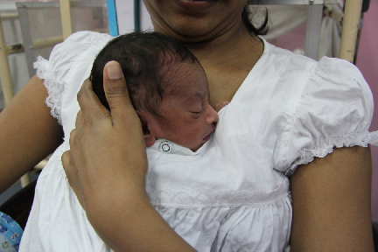
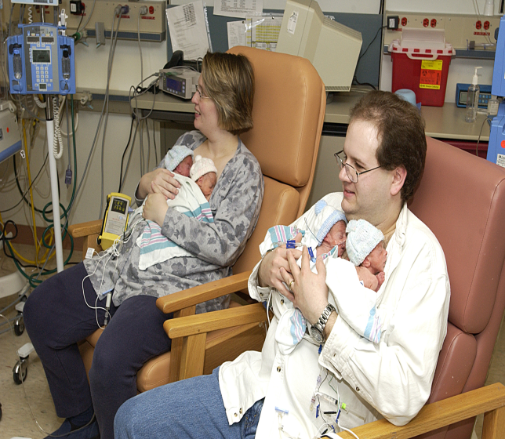

Slide 27
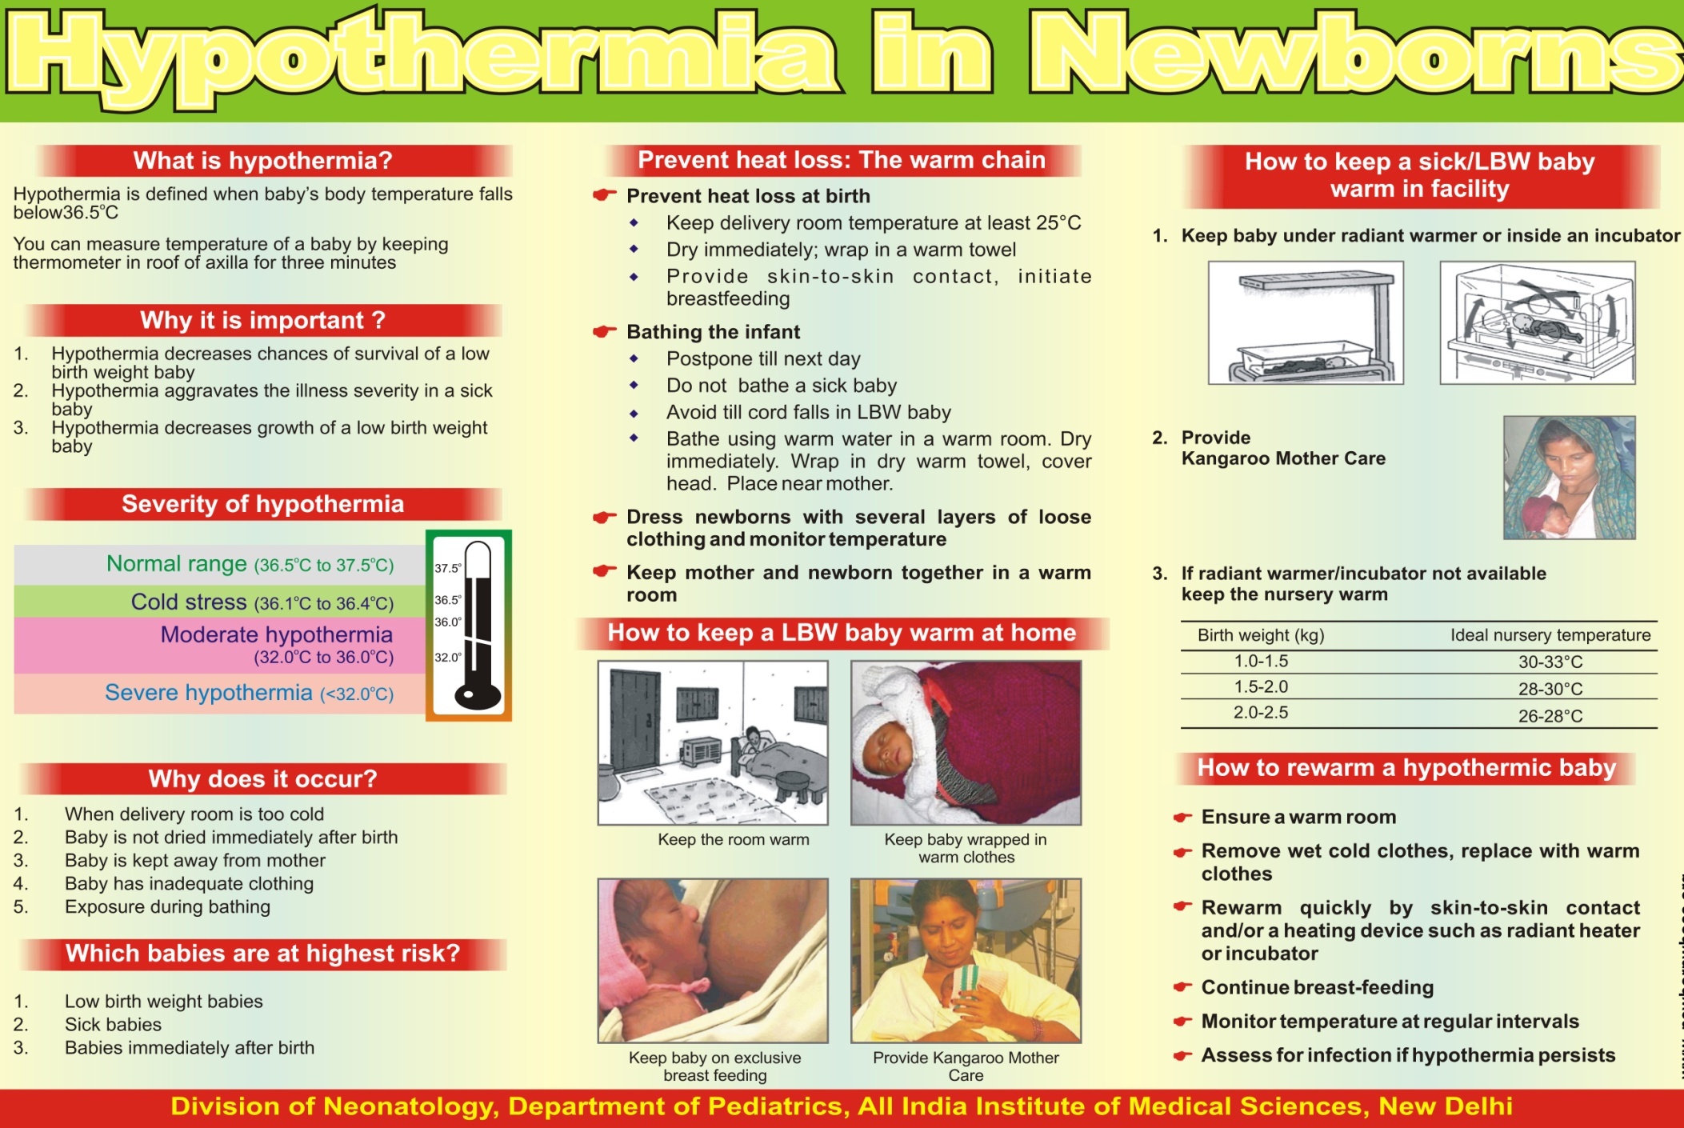

Slide 28
Hypoglycaemia - feeding
Reduced glycogen stores
Need to monitor blood glucose
Breastfeeding ideal
Expressed breast milk – by cup
Demand feeds as soon as possible
May rarely need intravenous fluids

Slide 29
Postnatal growth
Symmetrical IUGR (because of less cell numbers at birth):
are underdeveloped postnatally and
remain small throughout life
Asymmetrical IUGR (normal cell numbers)
good prognosis and
good postnatal growth
• Lower strength and work capacity

Slide 30
Neurological problems
Lower scores on cognitive testing
Difficulties in schools or require special education
Gross motor and minor neurologic dysfunction
Behavioral problems (attention deficit hyperactivity syndrome)
Cerebral palsy
Low social competence
Poor academic performance
Lower levels of intelligence
Hyperactive behaviour
Poor perceptual performance
Poor visuo-motor perception, motor

Slide 31
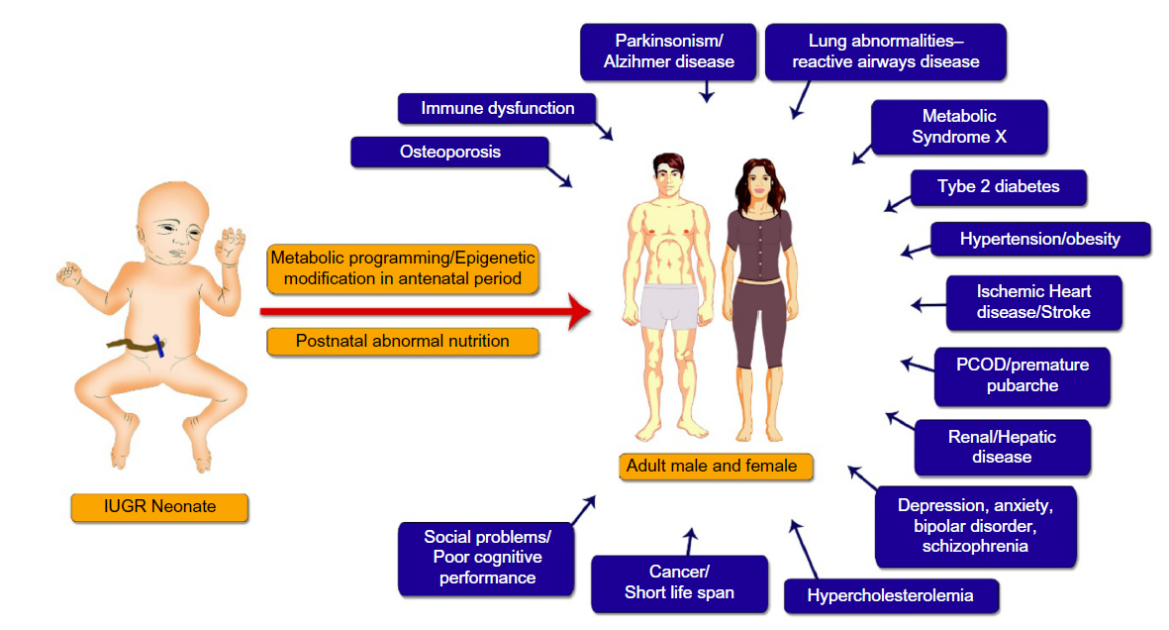
Developmental origin of health and diseases

Slide 32
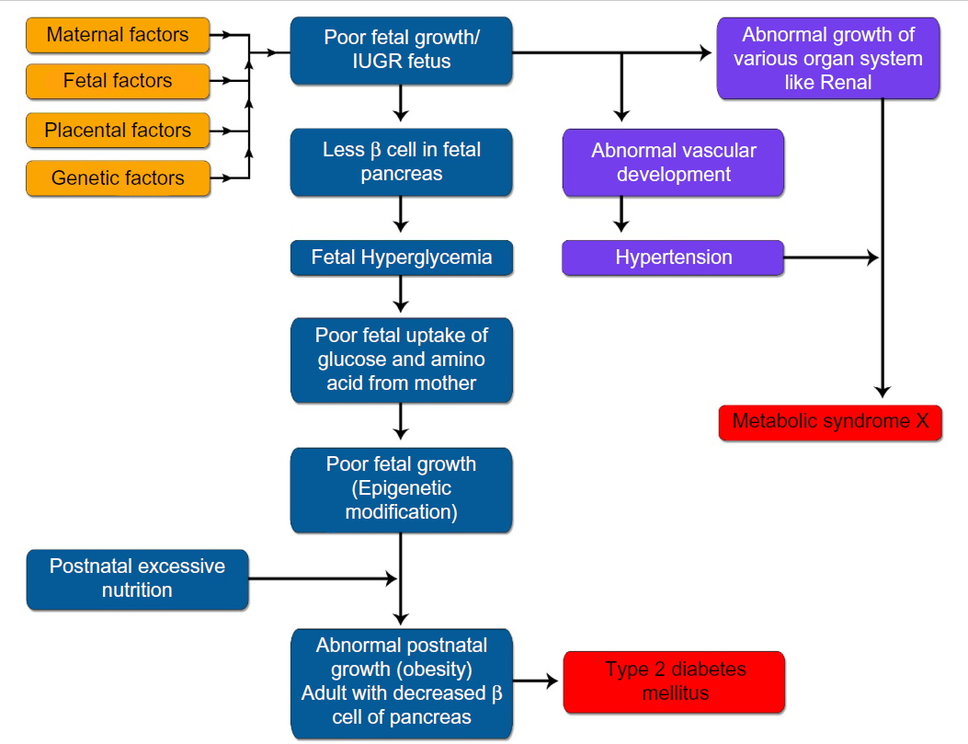
Barker hypothesis
Notes:
Fetal adaptations to adverse antenatal environment:
brain-sparing effect at the expense of other organ systems, and
reduced production and sensitivity to the fetal insulin and ILGF-I and also by the
upregulation of the hypothalamo-pitutary adrenal (HPA) axis.

Slide 33
Nutritional supplements
Vitamin D
All LBW infants who exclusively breast feed should receive 400IU daily of vitamin D
Multivitamin drops from the time the baby receives full enteral feeds.
Calcium and phosphorous
for all VLBW (1500g)
Iron supplementation from day 14

Slide 34
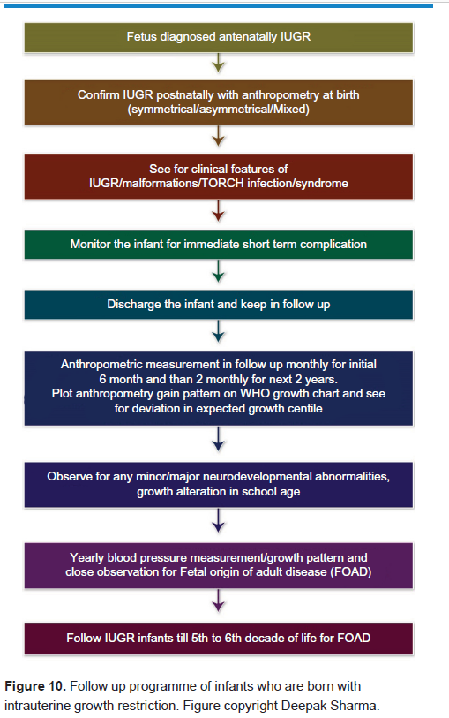
Summary

Slide 35
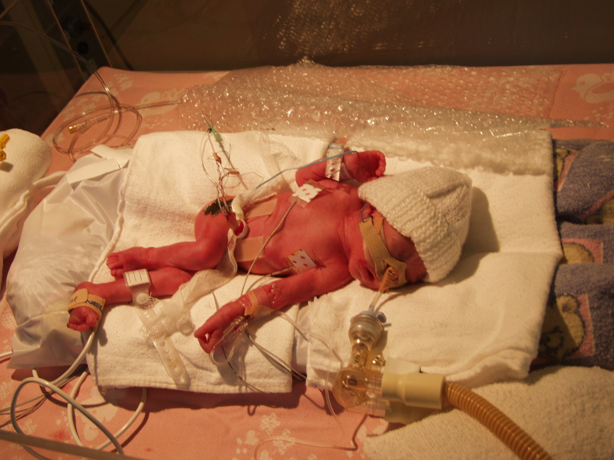

Slide 36
Approach to small baby
Talk to parents antenatally. Give idea of what to expect. Find out any issues.
Careful liaison with Obstetric team
Preparation of resuscitation equipment
ABC
Minimal handling
Neutral thermal environment
“Warm , Pink and Sweet”
Assess respiratory support needs: ? Vent ? CPAP ? Oxygen
Consider and cover infection
Nursery/incubator care
Venous access
Respiratory support as indicated

Slide 37
Approach to small baby
Consider context
Local resources
Screening for and management of known complications
Hypoglycaemia/IV fluids
GENTLE, minimalist approach
Early consultation with transport team (intra-uterine preferred)
EARLY re-discussion with parents

Slide 38


